Slide 1
Superconductors

Slide 2










Topics include……
Superconductivity and Superconductors
Discovery of superconductors
Zero Resistance
Effect of Magnetic Field
Meissner’s Effect
Classification of superconductors
Applications of superconductors

Slide 3

What is superconductivity?
“Superconductivity is a phenomenon of exactly zero electrical resistance and exclusion of the interior magnetic fields occurring in certain materials when cooled below a characteristic critical temperature”
“Materials which loose electrical resistance when cooled to very low temperatures are called as superconductors”

Slide 4
















































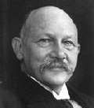
Discovery of Superconductivity
Superconductivity was discovered by Heike. Kammerlingh Onnes in 1911 who studied the resistance of solid mercury at cryogenic temperatures using liquid helium as refrigerant.
At the temperature of 4.2 K he observed that the resistance abruptly disappears
For this discovery he was awarded NOBLE
PRIZE in 1913
0.15
Resistance
(Ω)
0.10
T_{c}
4.0 4.1 4.2 4.3 4.4
Temperature (K)
0.0

Slide 5
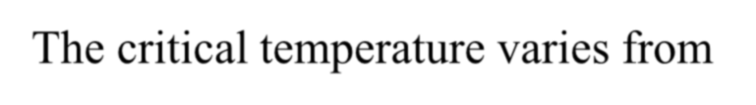

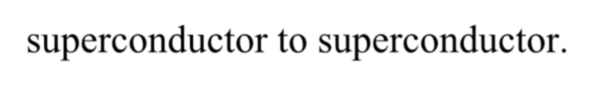
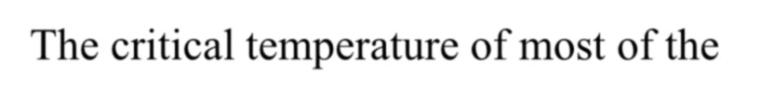
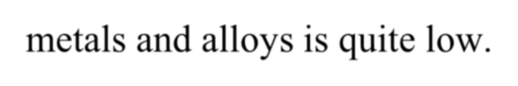
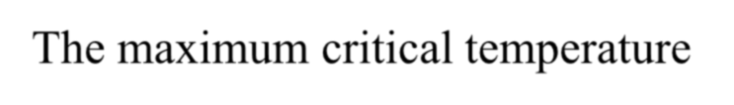
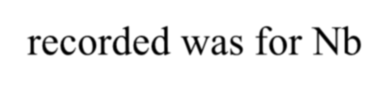
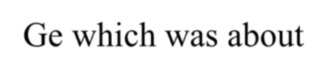

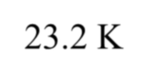
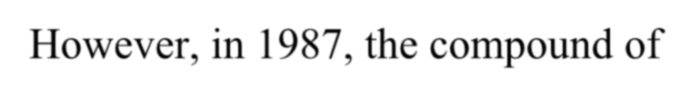
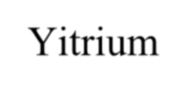
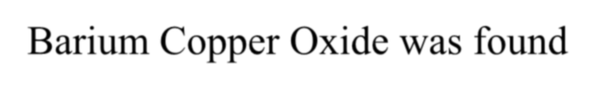
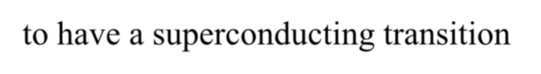

The critical temperature varies from superconductor to superconductor.
The critical temperature of most of the metals and alloys is quite low.
The maximum critical temperature recorded was for Nb₃Ge which was about
23.2 K
However, in 1987, the compound of Yitrium Barium Copper Oxide was found to have a superconducting transition temperature of nearly 90 K

Slide 6














Superconducting Transition temperatures of various elements and compounds
 | S.No. | Element/Compound | Transition Temperatures T_{C}
 | 1 | Cd | 0.55
 | 2 | Ga | 1.09
 | 3 | Sn | 3.72
 | 4 | Hg | 4.15
 | 5 | Pb | 7.2
 | 6 | CuS | 1.6
 | 7 | Bi Na | 2.25
 | 8 | Nb N | 16.0
 | 9 | Nb₃ Sn | 18.0
 | 10 | YBa₂Cu₃O₇ | 90

Slide 7
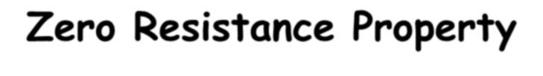










Zero Resistance Property
When cooled to very low temperatures certain metals and alloys can conduct electrical current with zero resistance. Hence these specific materials exhibit a new transition to superconducting state with zero resistance at temperatures called as critical or transition temperatures T_{C}
Thus at zero resistivity or infinite conductivity is observed in a superconductor at all temperatures below the critical temperature i.e. ρ=0 for all T<T_{C}

Slide 8


















The electric resistance of a superconductor at all temperatures below the critical temperatures is zero
From Ohm’s law E= ρJ, Where E is the electric field, ρ is the resistivity and J is the electric current density of the material
Zero resistivity implies zero electrical Field So from Max Well’s Equation
Curl E= - ∂B/∂t
As ρ =0;E=0 for a superconductor Hence ∂B/∂t=0

Slide 9
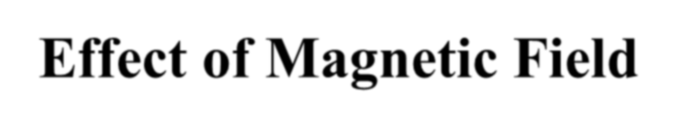










Effect of Magnetic Field
A Superconductor expels the magnetic field from its interior and has B=0
The superconducting state exists only in a particular range of temperatures and magnetic field strengths
It is important to know that superconductivity of a material will disappear if the temperature is raised above the critical temperature or if a sufficiently large magnetic field is employed

Slide 10
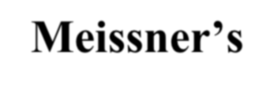
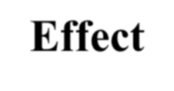




















Meissner’s Effect
Germen scientists Meissner and Ochsenfeld discovered the “Meissner’s Effect in 1933
The expulsion of magnetic field from the interior of a superconductor below T_{C} is called “Meissner’s Effect”
The Meissner’s effect is reversible i.e. when the temperature is raised from below T_{C} the magnetic flux penetrates the superconductor and behaves as normal conductor

Slide 11
















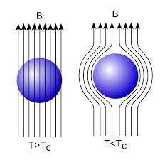
When the superconducting material is placed in the magnetic field under the conditions T≤T_{C} and H≤H_{C}, the flux lines are expelled from the material
Figure shows that when T>T_{C} or H>H_{C} the superconducting material behaves as normal conductor allowing the magnetic flux to penetrate in to the material and when T<T_{C} or H<H_{C}, the superconducting material expels the magnetic flux from its interior exhibiting superconductivity

Slide 12
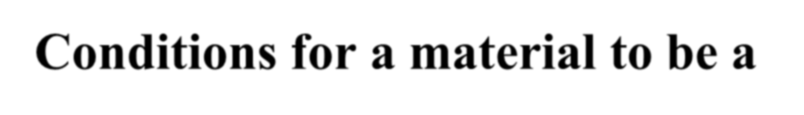
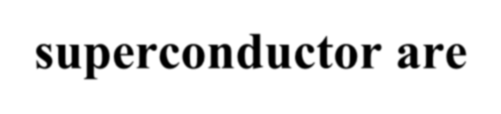
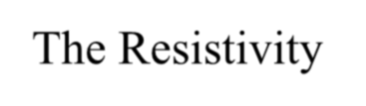

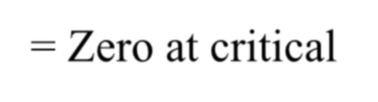

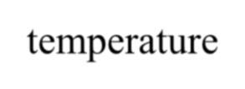
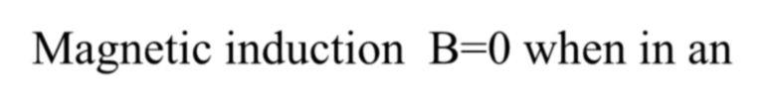
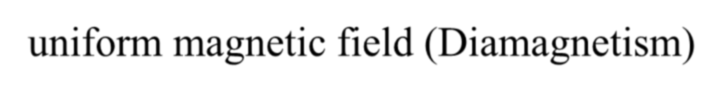
Conditions for a material to be a
superconductor are
The Resistivity ρ= Zero at critical temperature
Magnetic induction B=0 when in an uniform magnetic field (Diamagnetism)

Slide 13






























Classification of superconductors
Type I(Soft superconductors)
Sudden loss of magnetization
Exhibit Meissner Effect
No mixed state
Soft superconductor
H_{c} is 100 <H_{c1}
Eg. – Pb, Sn, Hg
Type II(Hard superconductors)
Gradual loss of magnetization
Does not exhibit complete
Meissner Effect
Mixed state present
Hard superconductor
H_{c1} is 100 >H_{c} of type I
Eg. – Nb-Sn, Nb-Ti
-M
Superconducting
Superconducting
-M
Mixed
Normal
Normal
H
^{H}C1
H_{C}
^{H}C2
C
H
H

Slide 14






Applications of Superconductors
Mag Lev Vehicles
The fundamental property of expulsion of magnetic flux from a superconductor and the consequent levitation of superconducting bodies above magnetic materials is the principle behind magnetic levitating trains. This reduces the friction. A high speed levitating train reaching speeds upto 550 km/hr on an average has been tested in Japan.

Slide 15











SQUIDs (Superconducting Quantum Interference Devices)
SQUIDs are used to measure the magnetic fields.
Very fast and accurate computers can be constructed using superconductors and the power consumption is very low
Superconductors can be used to transmit electrical power over long distances without any power or voltage drop
Superconductors are used in MRI to detect brain tumors, defective cells, damaged cells etc.

Slide 16
Thank you

